Slide 1
D3 (Day 2)
Let’s Create Some Charts Today

Slide 2
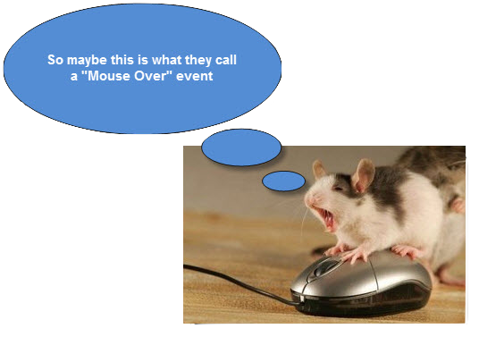
Handling Events

Slide 3
Event Handling
selection.on - add or remove event listeners.
selection.dispatch - dispatch a custom event.
d3.event - the current user event, during interaction.

Slide 4
Custom Events
Dispatches
d3.dispatch - create a custom event dispatcher.
dispatch.on - register or unregister an event listener.
dispatch.copy - create a copy of a dispatcher.
dispatch.call - dispatch an event to registered listeners.
dispatch.apply - dispatch an event to registered listeners.

Slide 5
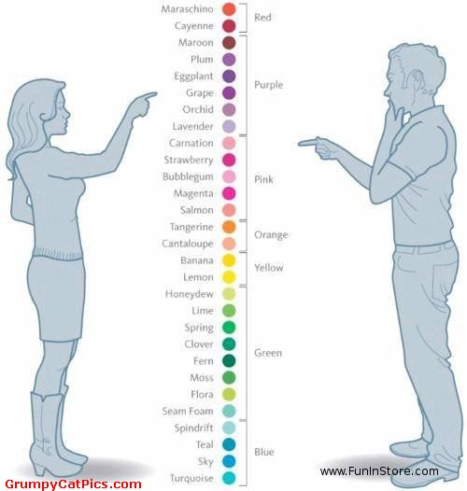
Scales and Axis

Slide 6
Scales
Continuous (Linear, Power, Log, Identity, Time)
Ordinal (Band, Point, Category)
Sequential
Quantize
Quantile
Threshold

Slide 7
Axis
d3.axisTop - create a new top-oriented axis generator.
d3.axisRight - create a new right-oriented axis generator.
d3.axisBottom - create a new bottom-oriented axis generator.
d3.axisLeft - create a new left-oriented axis generator.

Slide 8
Shapes
What are shape generators?
Lines
Area
Arc
Chord
Symbol
Diagonal

Slide 9
Drawing Lines
d3.line - create a new line generator.
line - generate a line for the given dataset.
line.x - set the x accessor.
line.y - set the y accessor.

Slide 10
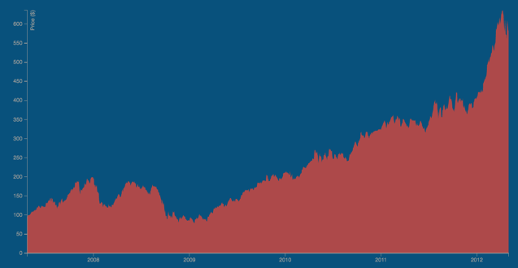
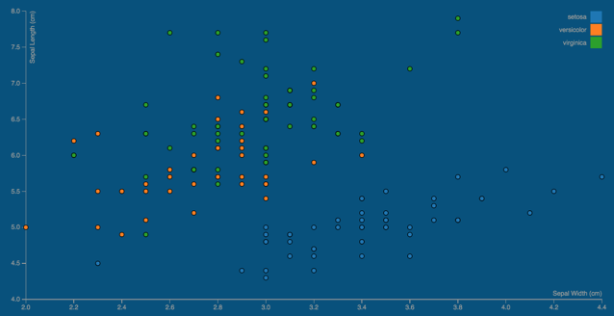
Some Other Simple Charts
Area Chart
Scatter Chart

Slide 11
